Slide 1
Chapter 2
Network Models

Slide 2
2-1 LAYERED TASKS
We use the concept of layers in our daily life. As an example, let us consider two friends who communicate through postal mail. The process of sending a letter to a friend would be complex if there were no services available from the post office.
Topics discussed in this section:
Sender, Receiver, and Carrier Hierarchy

Slide 3
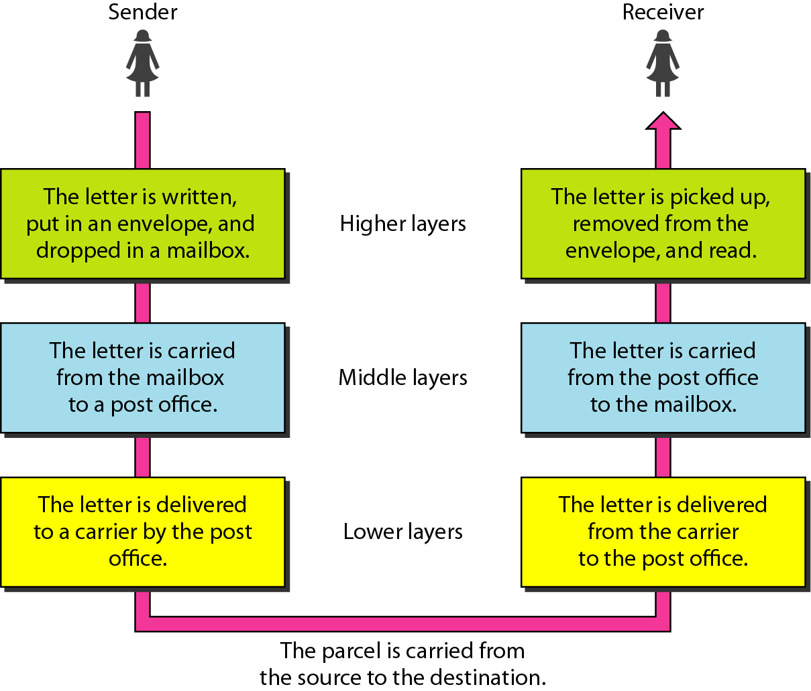
Figure 2.1 Tasks involved in sending a letter

Slide 4
Layering
Task of communication broken up into layers
Communication
Task
Layer 1
Layer 2
Layer 3
‹#›

Slide 5





Layers involving calling a friend
‹#›

Slide 6
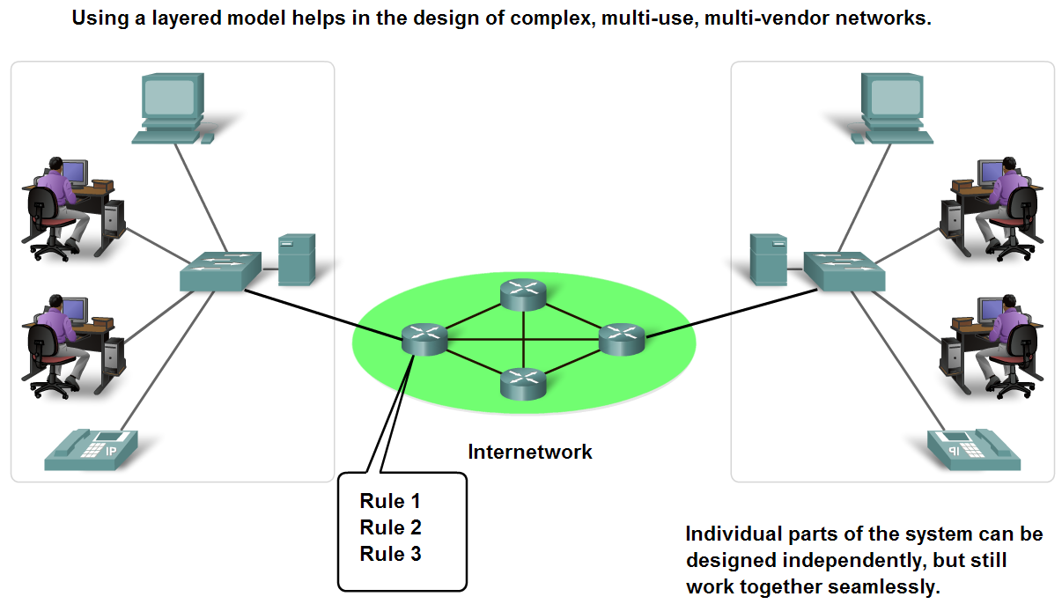
Benefits of using a layered model
To find out the fault easily.
Changes in one layer do not affect other layers.
Have defined information that they act upon.
‹#›

Slide 7
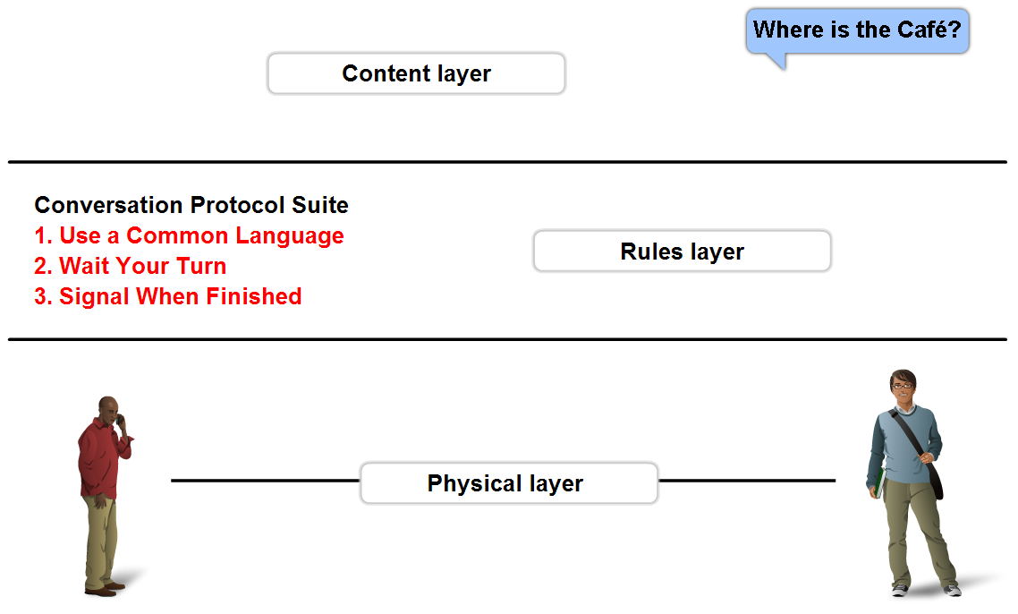
Rules that govern communications
A protocol is a set of predetermined rules.
Defines:
What is communicated??
How it is communicated??
When it is communicated??
‹#›

Slide 8
Protocols
Describe processes such as:
The format or structure of the message.
What?
The method by which networking devices share information about pathways with other networks.
How?
How and when error and system messages are passed between devices.
How/When?
The setup and termination of data transfer sessions.
What/When/How?
‹#›

Slide 9
Protocols and Standards
Protocols
Standards
Standards Organizations
Internet Standards
‹#›

Slide 10
Standards
Endorsed by the networking industry and approved by a standards organization.
Benefits:
Create and maintain an open and competitive market.
Ensured greater compatibility and interoperability.
Categories
De facto: Standards that have not been approved by an organized body but have been adopted as standards through widespread use
De jure: Those standards that have been legislated by an officially recognized body
‹#›

Slide 11
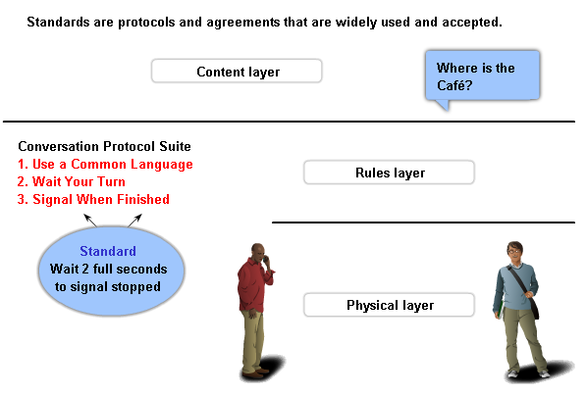
Standards and Protocols
‹#›

Slide 12
Standard Organizations
International Organization for Standardization (ISO)
Institute of Electrical and Electronic Engineers (IEEE)
American National Standards Institute (ANSI)
Telecommunications Industry Association (TIA)
The Internet Engineering Task Force (IETF)
International Telecommunications Union – Telecommunication Standards Sector (ITU-T)
‹#›

Slide 13
Communication Process
Layered standards:
OSI Reference model
De Jure Standard
TCP/IP Protocol Model
Open De Facto Standard
Governed by IETF Working Groups
‹#›

Slide 14
2-2 THE OSI MODEL
Established in 1947, the International Standards Organization (ISO) is a multinational body dedicated to worldwide agreement on international standards. An ISO standard that covers all aspects of network communications is the Open Systems Interconnection (OSI) model. It was first introduced in the late 1970s.
Topics discussed in this section:
Layered Architecture Peer-to-Peer Processes
Encapsulation

Slide 15

Note
ISO is the organization. OSI is the model.

Slide 16
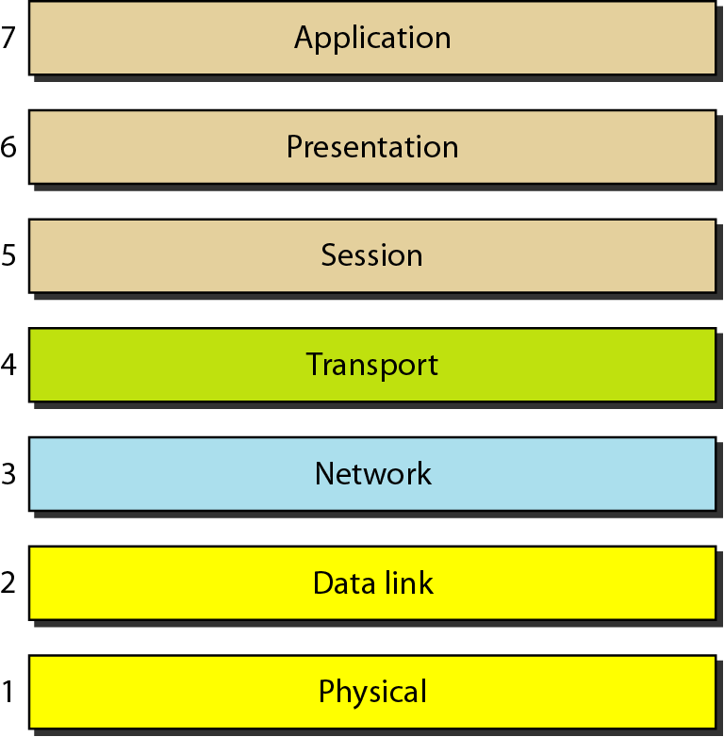
Figure 2.2 Seven layers of the OSI model

Slide 17
OSI Model- 7 Layers
Layers |  | CISCO
7 | Application | All
6 | Presentation | People
5 | Session | Seem
4 | Transport | To
3 | Network | Need
2 | Data Link | Data
1 | Physical | Processing
Primary concern: Communications between applications
Primary concern: Moving raw data cross the network
‹#›

Slide 18
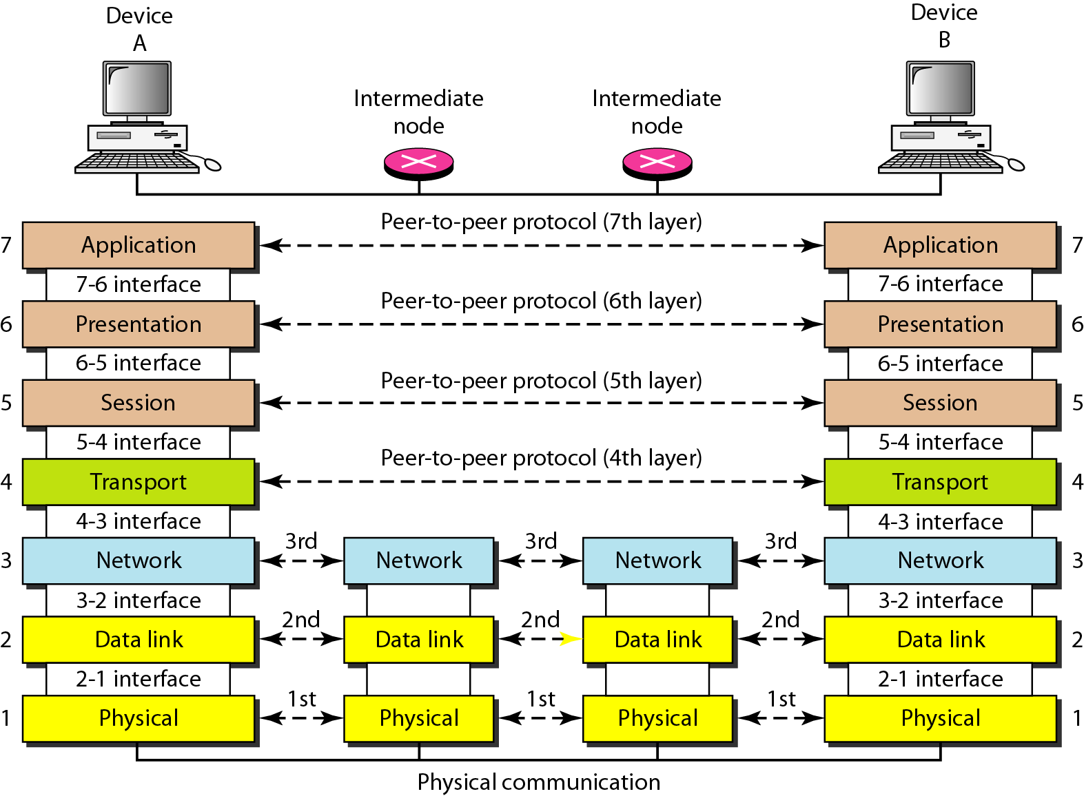
Figure 2.3 The interaction between layers in the OSI model

Slide 19
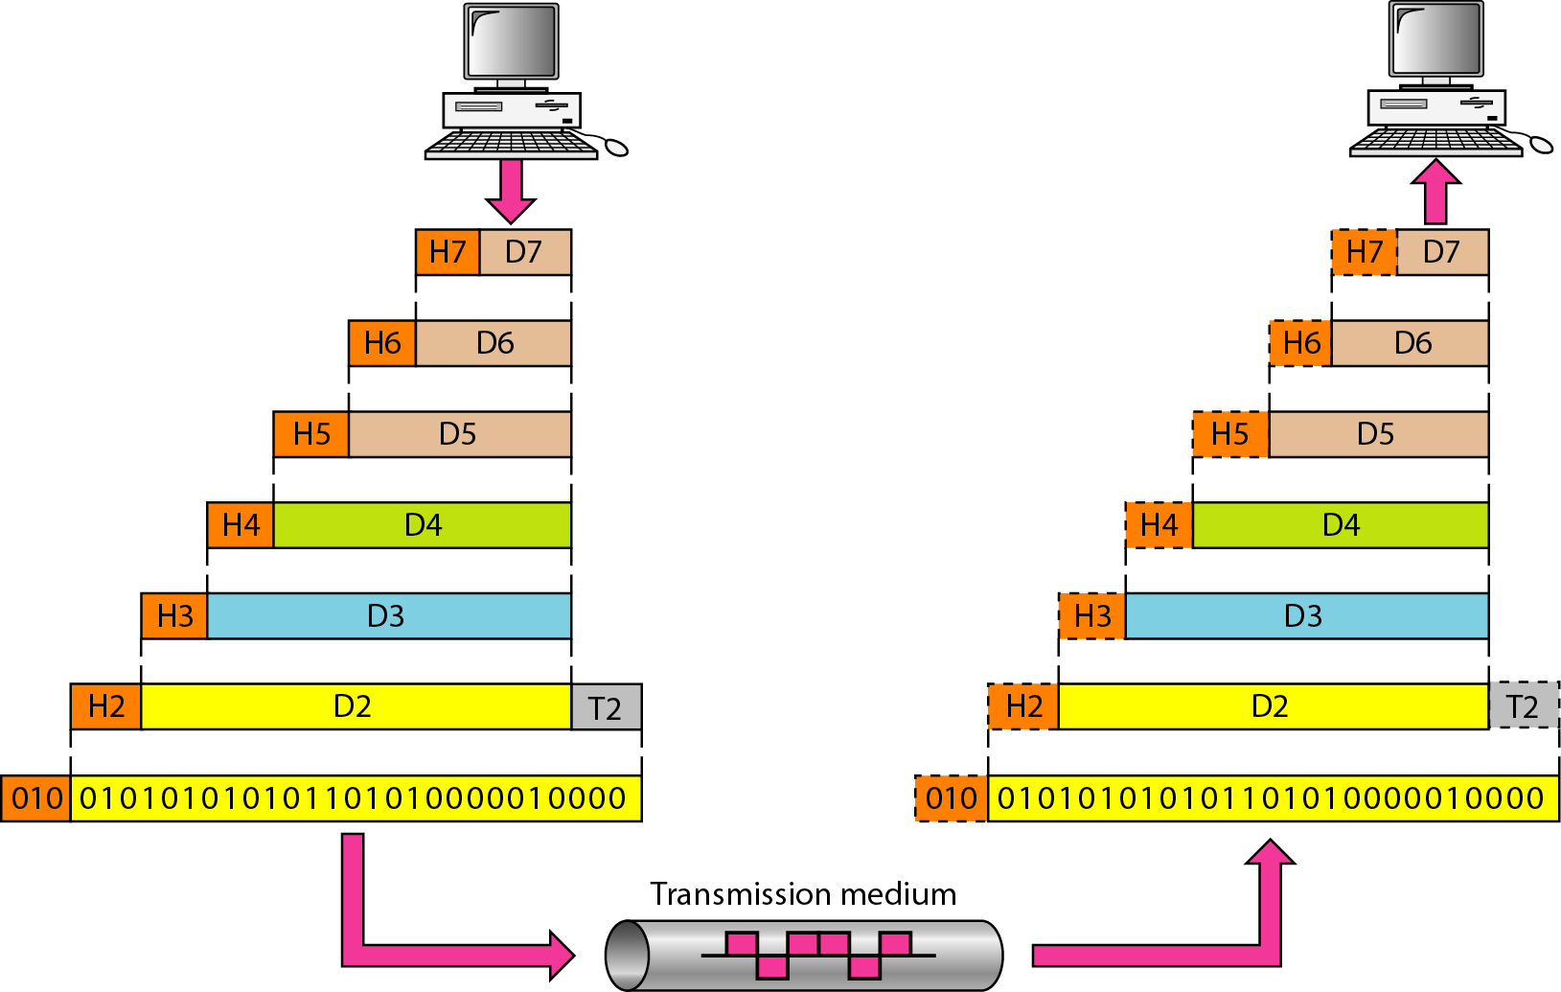
An exchange using the OSI model
‹#›

Slide 20
2-3 LAYERS IN THE OSI MODEL
In this section we briefly describe the functions of each layer in the OSI model.
Topics discussed in this section:
Physical Layer Data Link Layer
Network Layer
Transport Layer
Session Layer
Presentation Layer
Application Layer

Slide 21
APPLICATION LAYER
2.#
‹#›

Slide 22
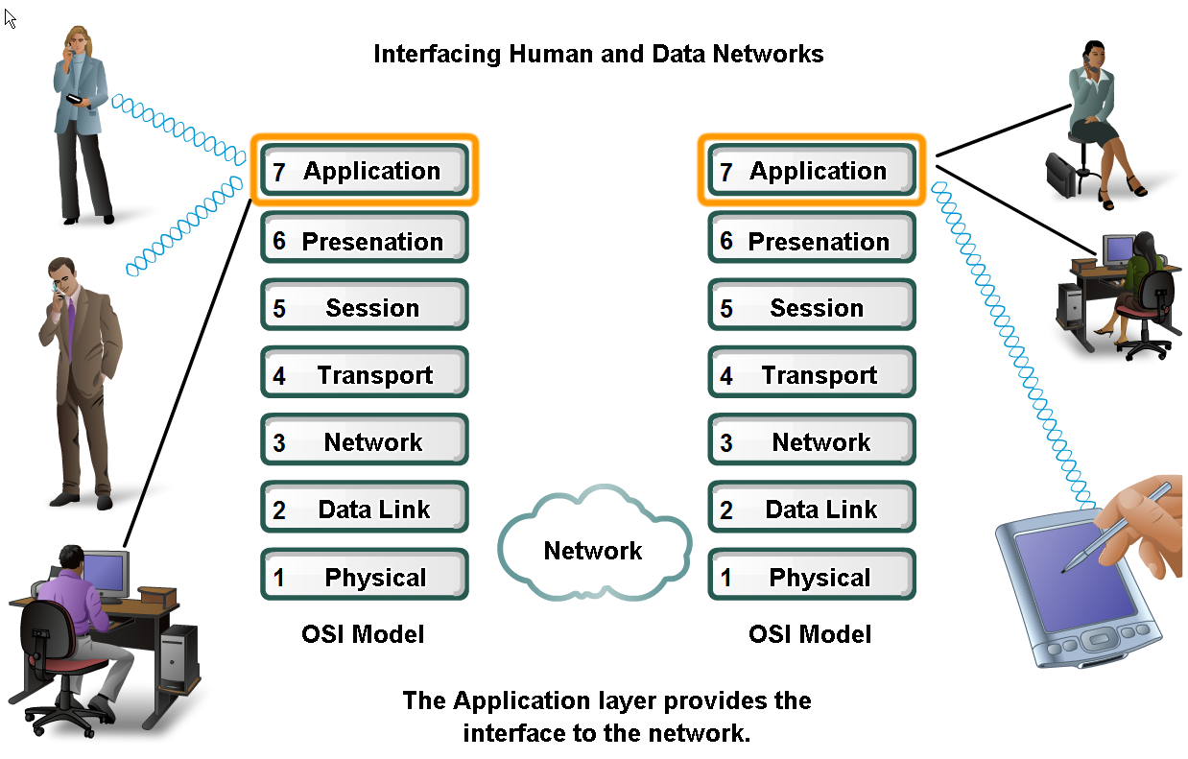
Applications
The Interface Between Human and Data Networks
Responsible for providing services to the user.
‹#›

Slide 23
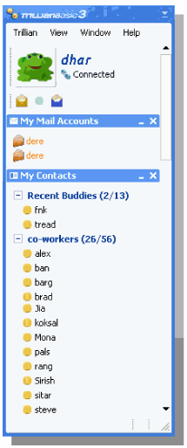
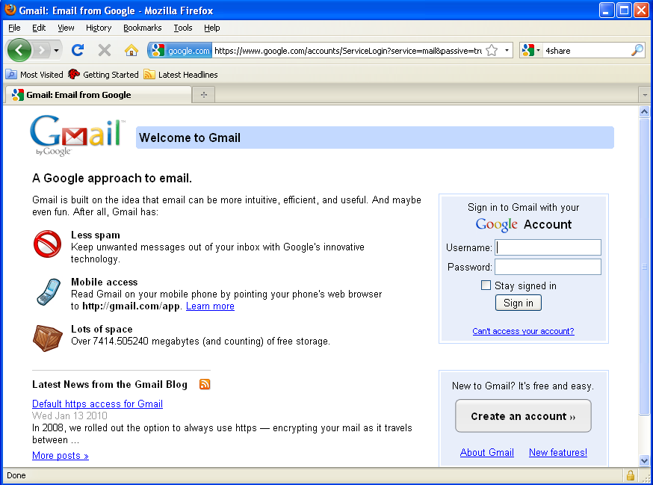
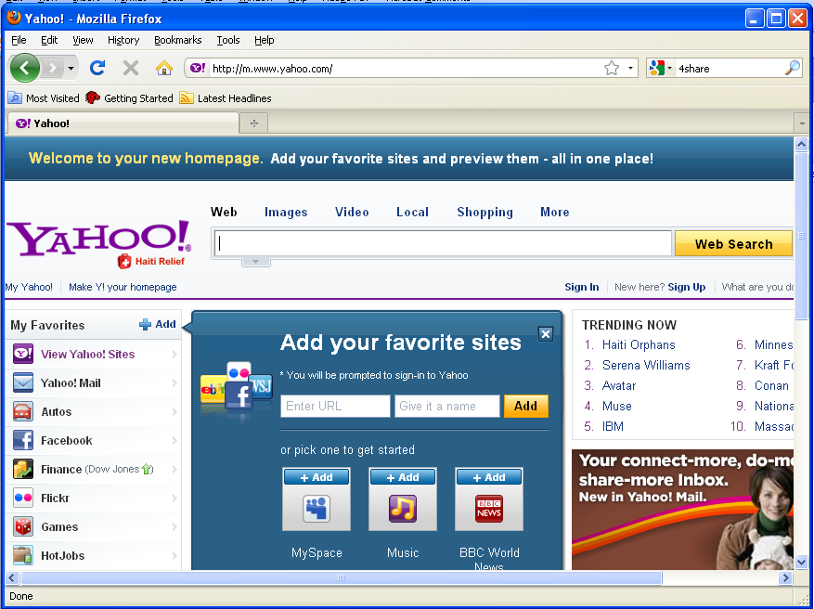
Applications in Application layer
Web Page
Email
Instant messaging
‹#›

Slide 24
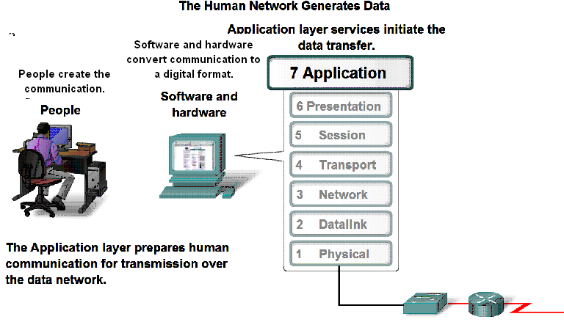
Application Layer
‹#›

Slide 25

Applications in Application layer
Web Page
Email
Instant messaging
Header
H7
Data
To Presentation Layer
‹#›

Slide 26
Application layer
Web Page
Email
Instant messaging
Header
H7
Data
From Presentation Layer
‹#›

Slide 27
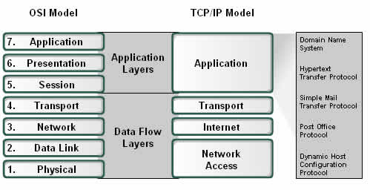
Application Layer
Examples of Protocols
DNS
HTTP
SMTP
POP
DHCP
‹#›
‹#›

Slide 28
PRESENTATION LAYER
2.#
‹#›

Slide 29
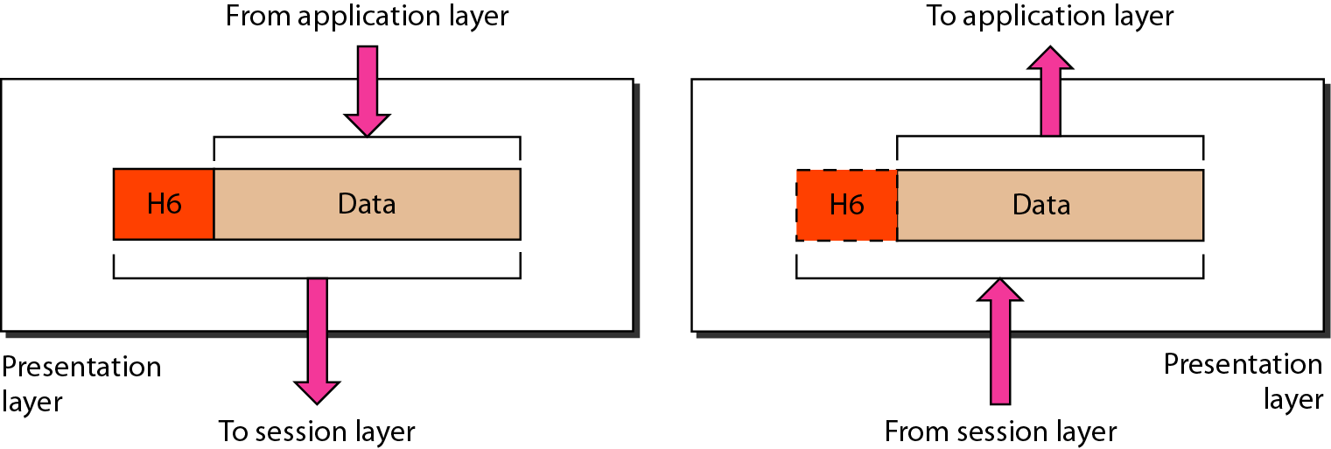
Presentation layer
The presentation layer is responsible for translation, compression, and encryption.
‹#›

Slide 30
Presentation Layer
3 primary functions:
Coding and conversion
Compression of the data
Encryption of the data
Presentation layer implementations are not typically associated with a particular protocol stack.
‹#›

Slide 31
SESSION LAYER
2.#
‹#›

Slide 32
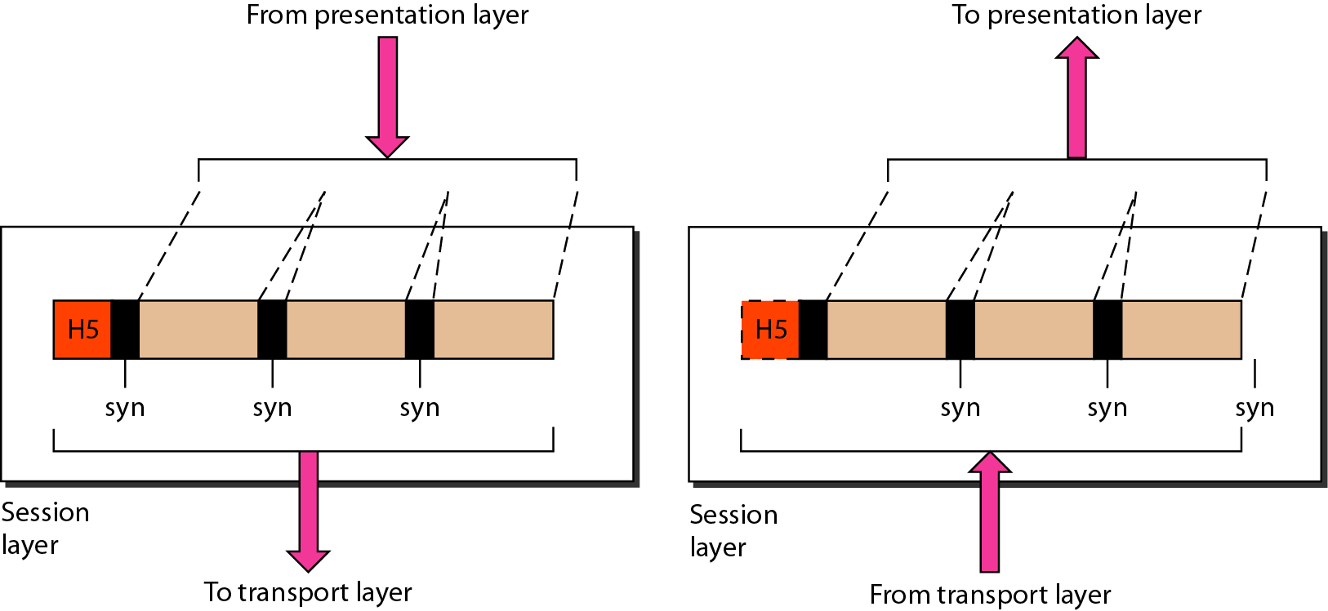
Session layer
The session layer is responsible for dialog control and synchronization.
‹#›

Slide 33
Session Layer
It handles the exchange of information
to initiate dialogs,
keep them active, and
to restart sessions that are disrupted or idle for a long period of time
Most applications, like web browsers or e-mail clients, incorporate functionality of the OSI layers 5, 6 and 7.
‹#›
‹#›

Slide 34
TRANSPORT LAYER
2.#
‹#›

Slide 35
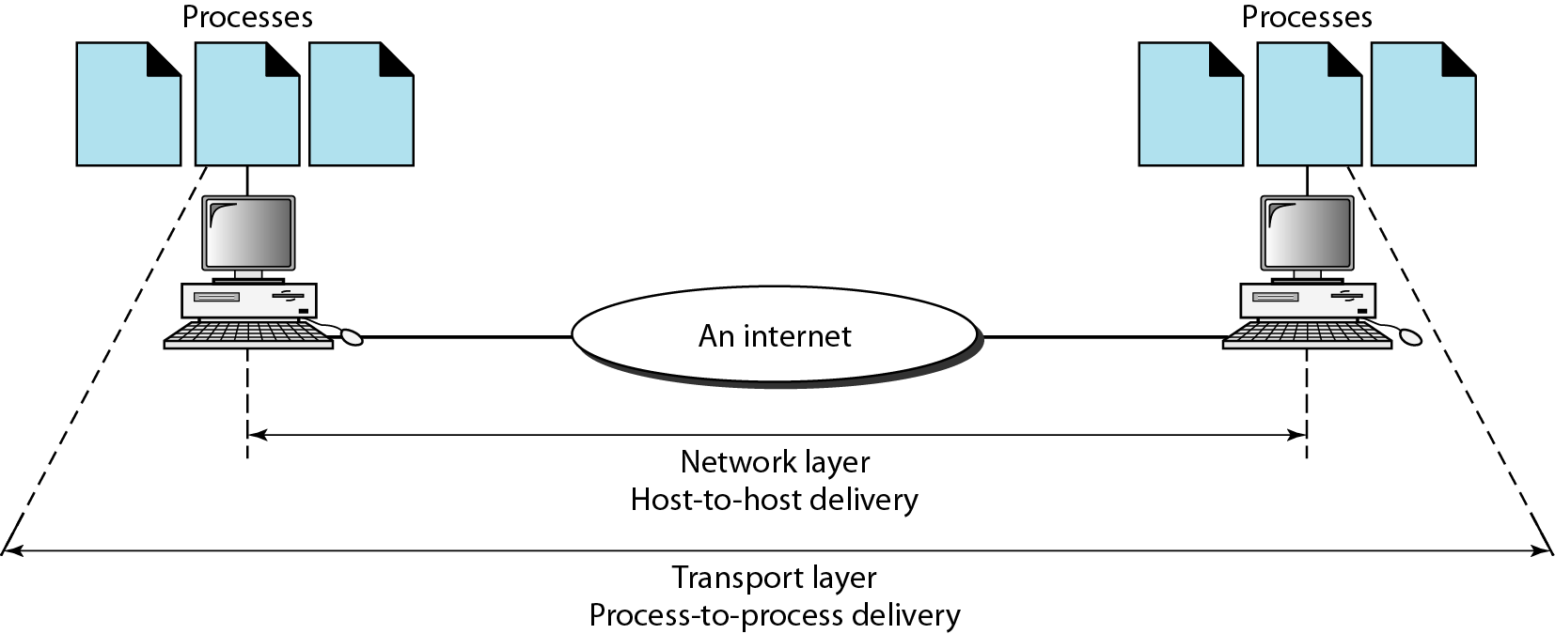
Transport layer
The transport layer is responsible for the delivery of a message from one process to another.
‹#›

Slide 36
Functions– Transport Layer
Segmentation and Reassembly
Adds Port Address and Sequence Number.
Connection Control
Flow and Error Control
Multiplexing
Transport Layer PDU is called Segments.
Common Protocol used in Transport Layer is TCP
‹#›

Slide 37
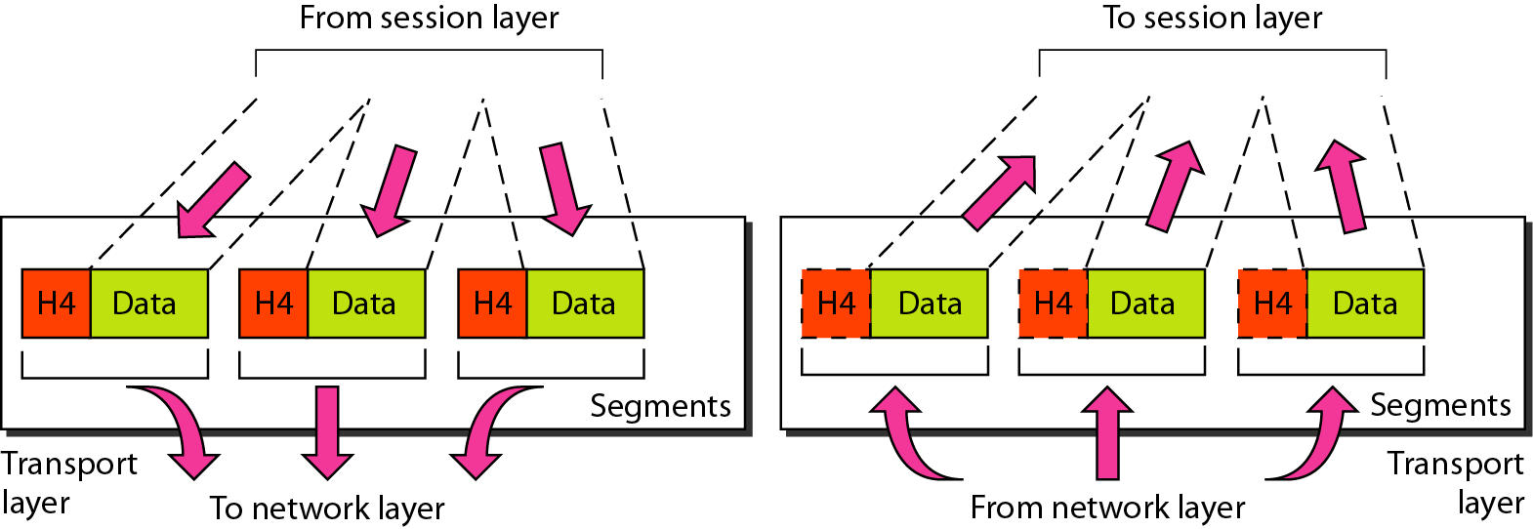
Transport layer
Segments data received from application layer into small parts.
Transport Layer Protocol Data Unit is called Segments.
‹#›

Slide 38
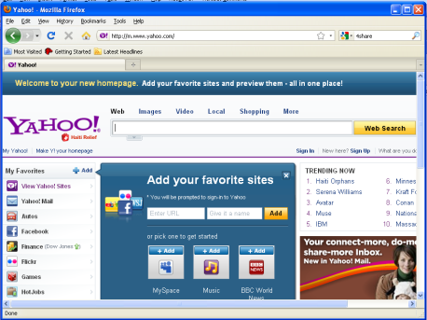
Function: Segmentation
A1
A2
Data from Application layer
1
Segments into small parts
Received by Transport Layer
2
Add a number to identify the application.
1
2
3
3
A1
A1
A1
Add a number sequence the segmented parts.
‹#›

Slide 39
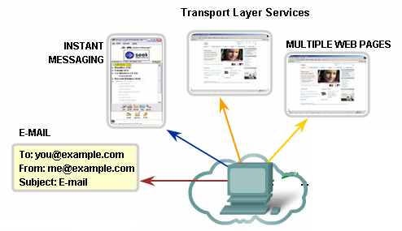
Identifying Different Applications
Port Numbers
‹#›

Slide 40
Port Address
To define multiple processes running in a computer.
16-bit in length
80
A 16-bit port address represented as one single number.
‹#›

Slide 41
Function: Connection Control
Are you up?
Yes
Data
‹#›

Slide 42
Function: Flow Control
Host B has too many packets to process.
Buffer to store incoming packets overflows
Data
Please send less packets.
Host A
Host B
‹#›

Slide 43
Function: Error Control
1
I have 1&3, where is 2?
3
Data
Please send packet 2.
X
Lost in transition
Host A
Host B
‹#›

Slide 44
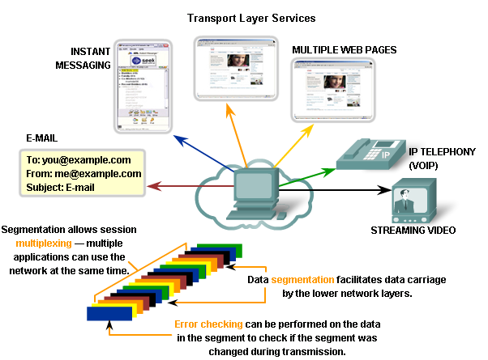
Functions– Multiplexing
‹#›

Slide 45
NETWORK LAYER
2.#
‹#›

Slide 46
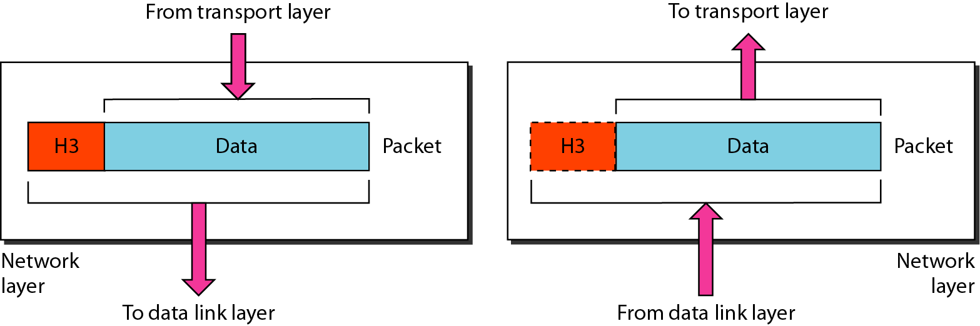
Network layer
The network layer is responsible for the delivery of individual packets from the source host to the destination host.
‹#›

Slide 47
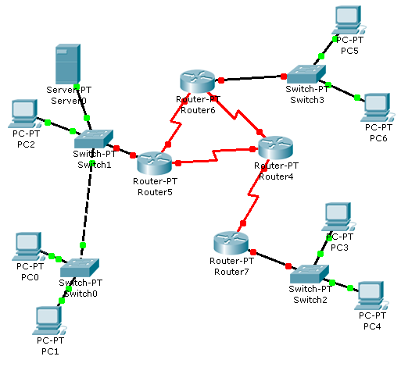
Example
LAN 2
?
?
LAN 1
?
?
Interconnections
LAN 3
Receiver
‹#›
Sender

Slide 48
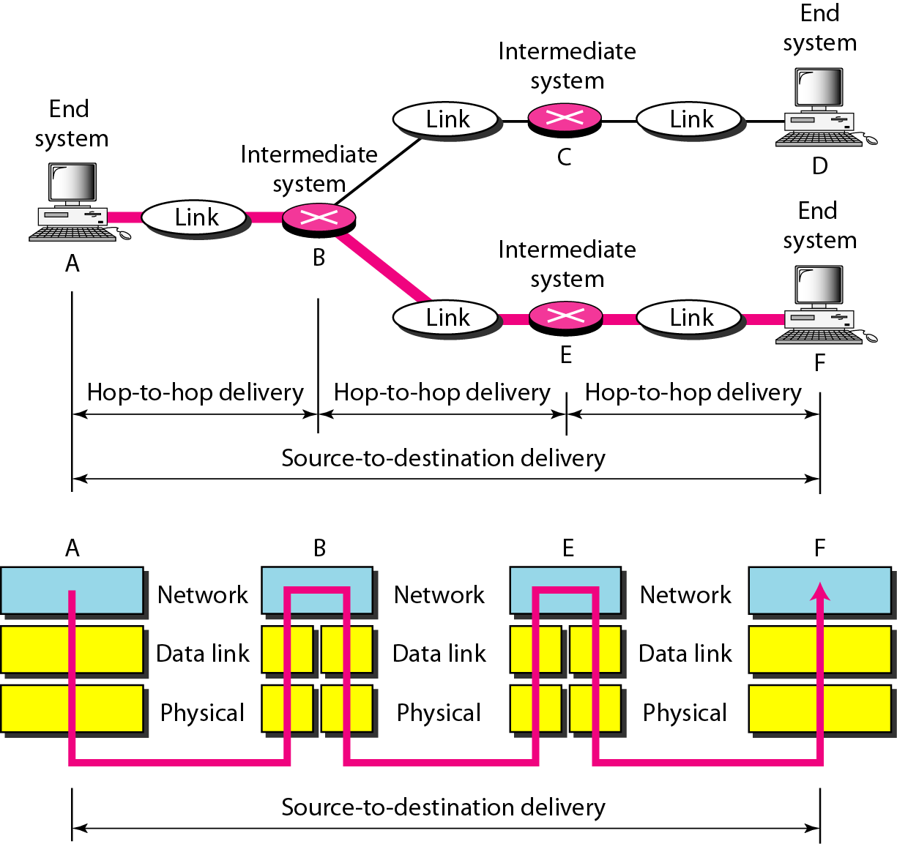
Source-to-destination delivery
Functions :
Adds an address to identify sender and receiver hosts.
Decides which path to take.
Adds Logical Addressing
Routing
A
F
‹#›

Slide 49
Source-to-destination delivery
Network Layer PDU is called Packets.
Common Network layer Protocol is called Internet Protocol (IP)
‹#›

Slide 50
Logical Addresses :: IP Address
Universal address, each host uniquely defined.
32-bit address also known as IP Address.
Independent of underlying physical networks.
192.168.10.1 32 bits written in dotted decimal notation. Each decimal represented by 8 bits.
‹#›

Slide 51
DATALINK LAYER
2.#
‹#›

Slide 52
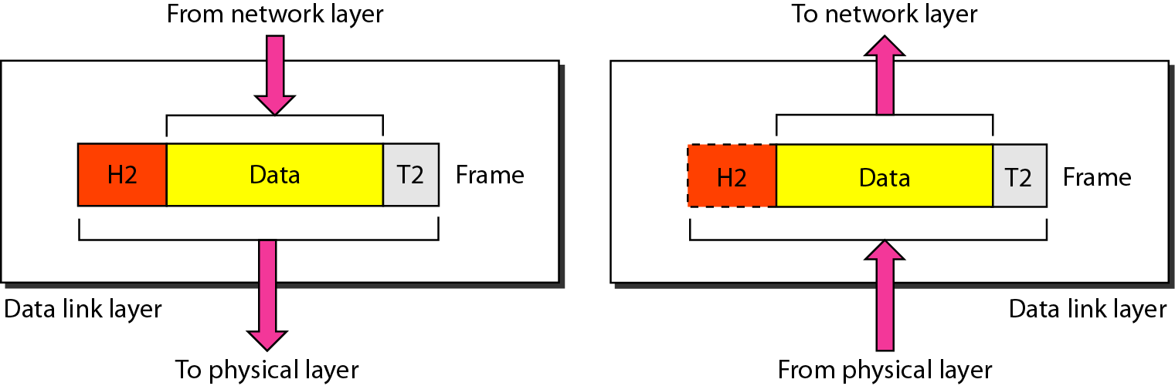
Data link layer
The data link layer is responsible for moving frames from one hop (node) to the next.
‹#›

Slide 53
Functions-Data Link Layer
Framing.
Physical Addressing
Flow Control
Error Control
Access Control
Data Link Layer PDU is called Frames.
Data Link Layer Protocol varies.
‹#›

Slide 54
Functions : Framing
From Network Layer
Header
H2
Data
Trailer
T2
Data Link Layer
To Physical Layer
‹#›

Slide 55
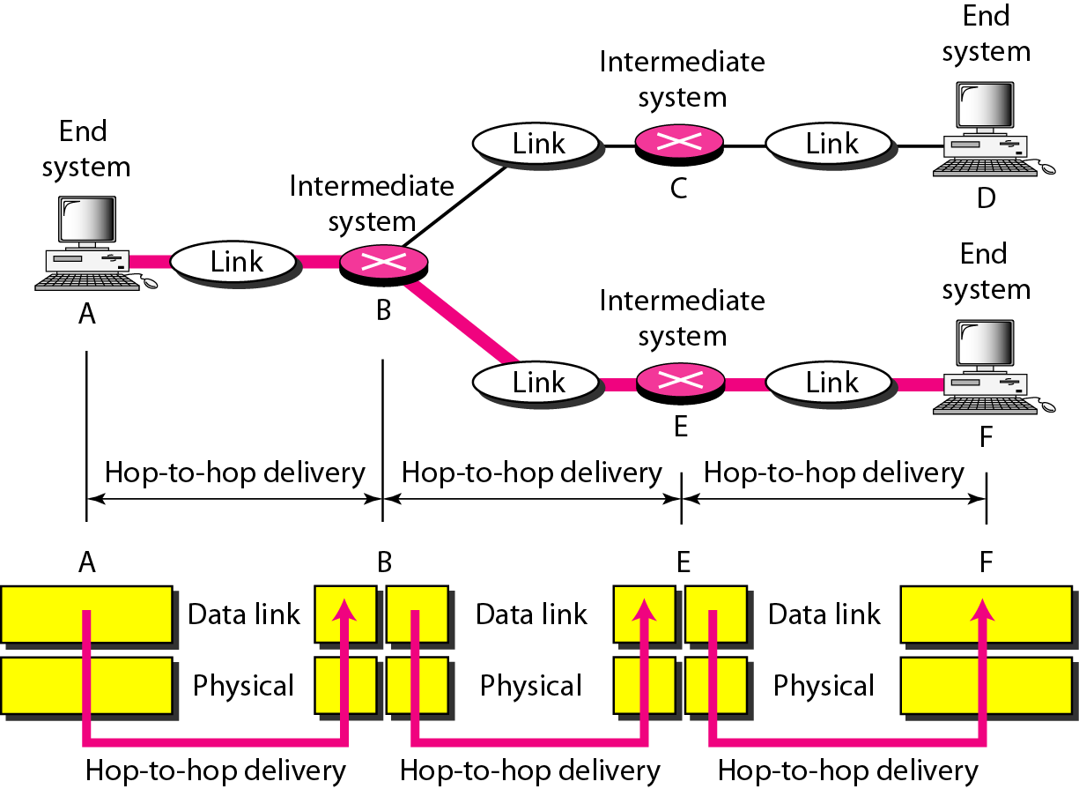
Hop-to-hop delivery
‹#›

Slide 56
Physical Address : MAC Address
Every interface/port has an unique identifying number.
Given by manufacturer.
48 bits long, represented by 12 hexadecimal digits.
07:01:02:01:2C:4B
Also known as MAC (Media Access Control) Address.
‹#›

Slide 57

Addressing
Assume:
IP Addresses – Alphabets
MAC Addresses - Numbers
22
21
M
A
F/22
D/13
G/31
32
31
M
A
E/21
H/32
B/12
42
M
A
41
IP address
MAC address
IP address
N/41
MAC address
M/42
A/11
13
11
M
A
Receiver
Sender
‹#›
D S D S

Slide 58
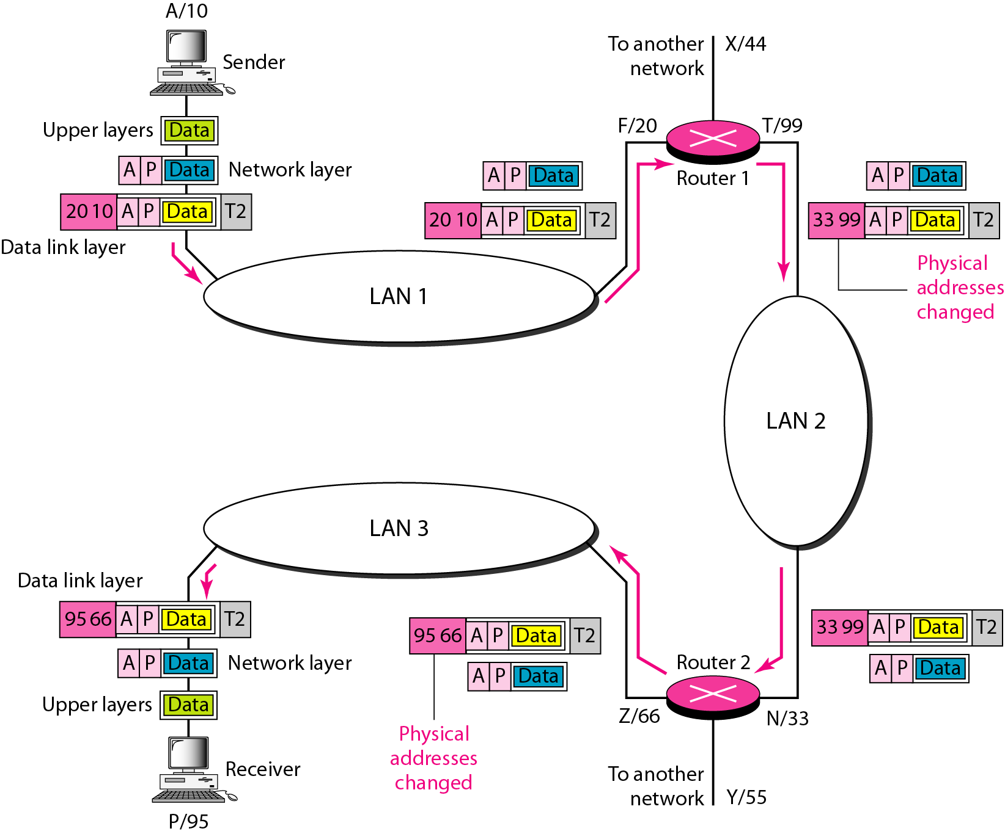
Addressing
‹#›

Slide 59
Addressing-Within the same network
Assume:
IP Addresses – Alphabets
MAC Addresses - Numbers
E/15
D/14
C/13
Receiver
B/12
A/11
14
11
D
A
Sender
‹#›

Slide 60
PHYSICAL LAYER
2.#
‹#›

Slide 61
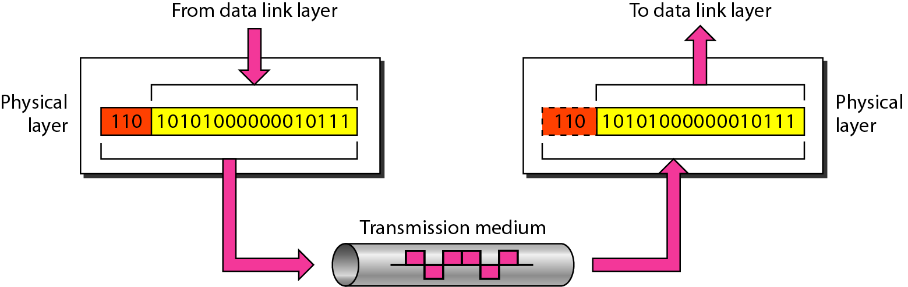
Physical layer
The physical layer is responsible for movements of
individual bits from one hop (node) to the next.
‹#›

Slide 62
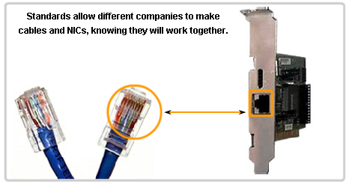
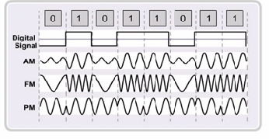
Functions-Physical Layer
Physical Characteristics of interfaces and medium.
Representation of bits
Data Rate
Synchronization of bits
‹#›

Slide 63
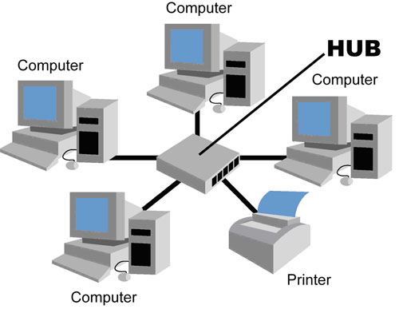
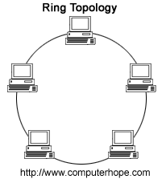
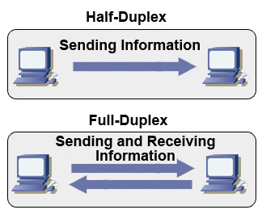
Functions-Physical Layer
Physical Topology
Bus
Ring etc
Transmission Modes
Simplex
Half Duplex
Full Duplex
‹#›

Slide 64
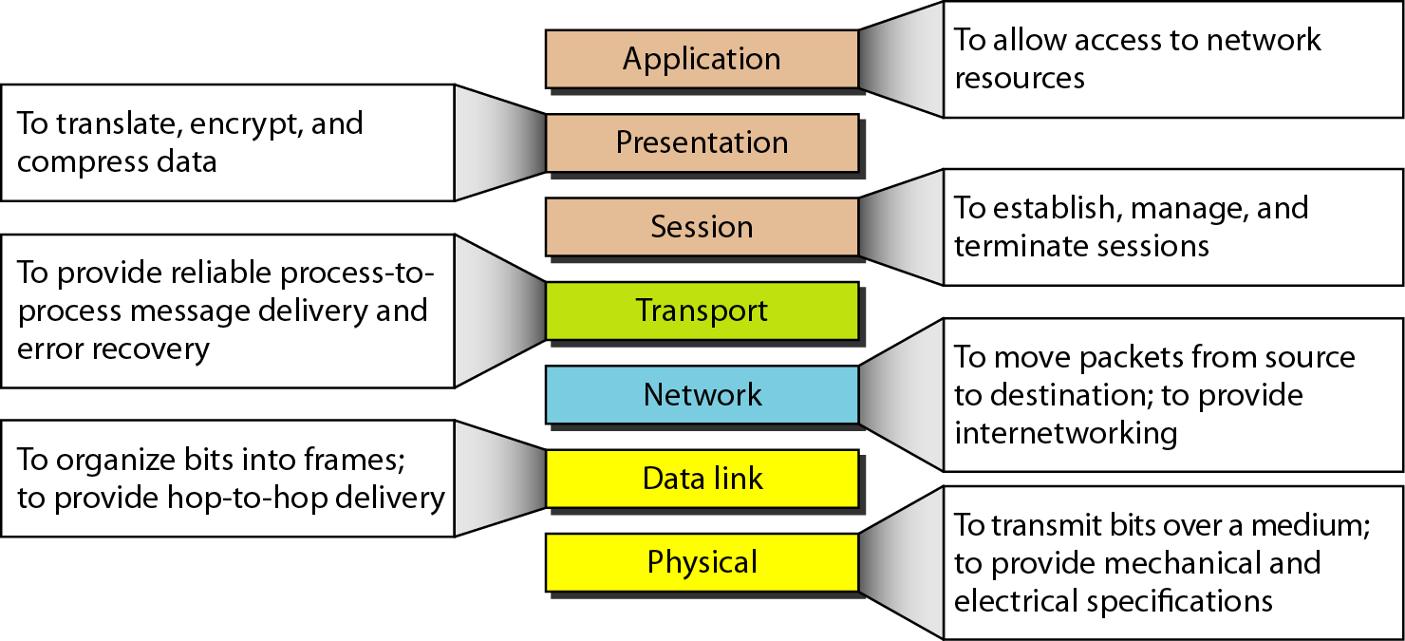
Summary of OSI Layers
‹#›

Slide 65
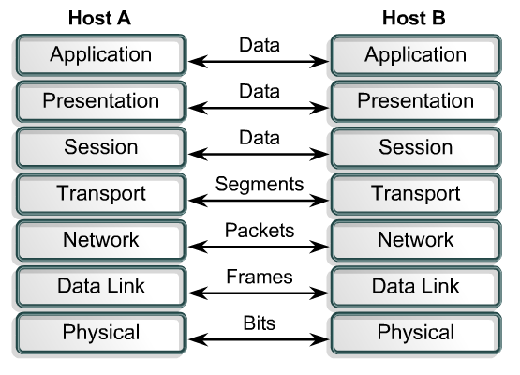
Summary
PDUs
Encapsulation
Headers and trailers
‹#›

Slide 66
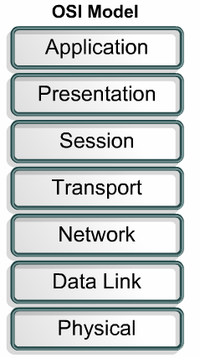
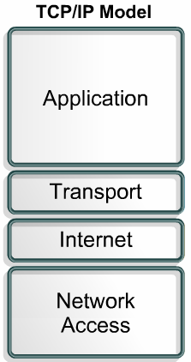
TCP/IP
Developed by the US Defense Advanced Research Project Agency (DARPA) for its packet switched network (ARPANET)
Used by the global Internet.
De Facto Standard
‹#›

Slide 67
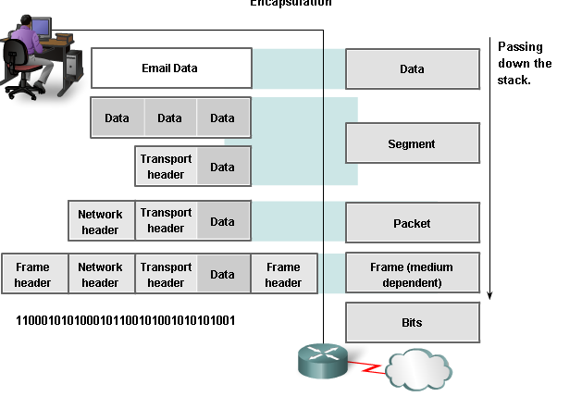
TCP/IP Encapsulation
‹#›

Slide 68
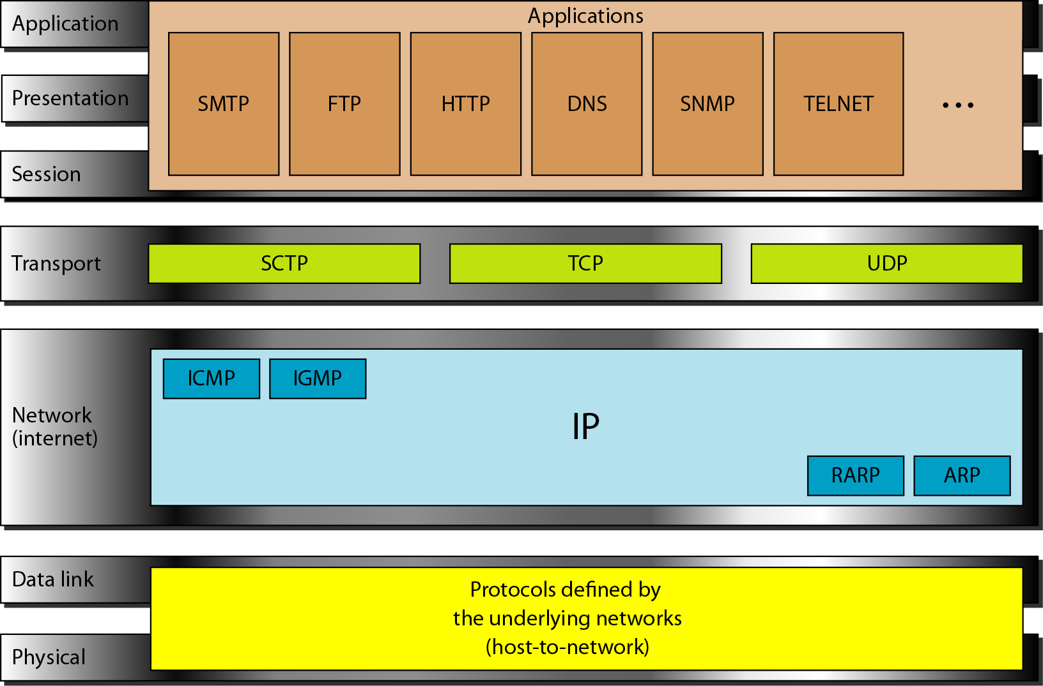
TCP/IP and OSI model
‹#›

Slide 69
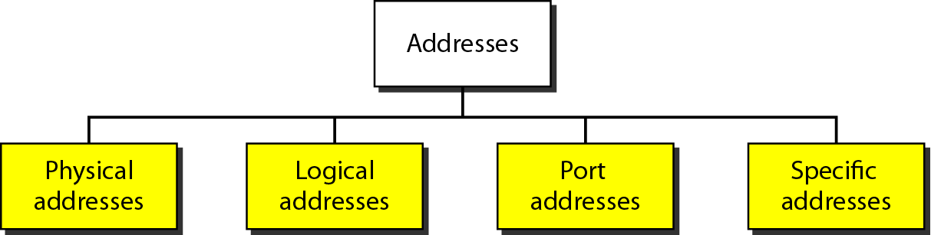
Addressing Summary
Four levels of addresses are used in an internet employing the TCP/IP protocols
‹#›

Slide 70
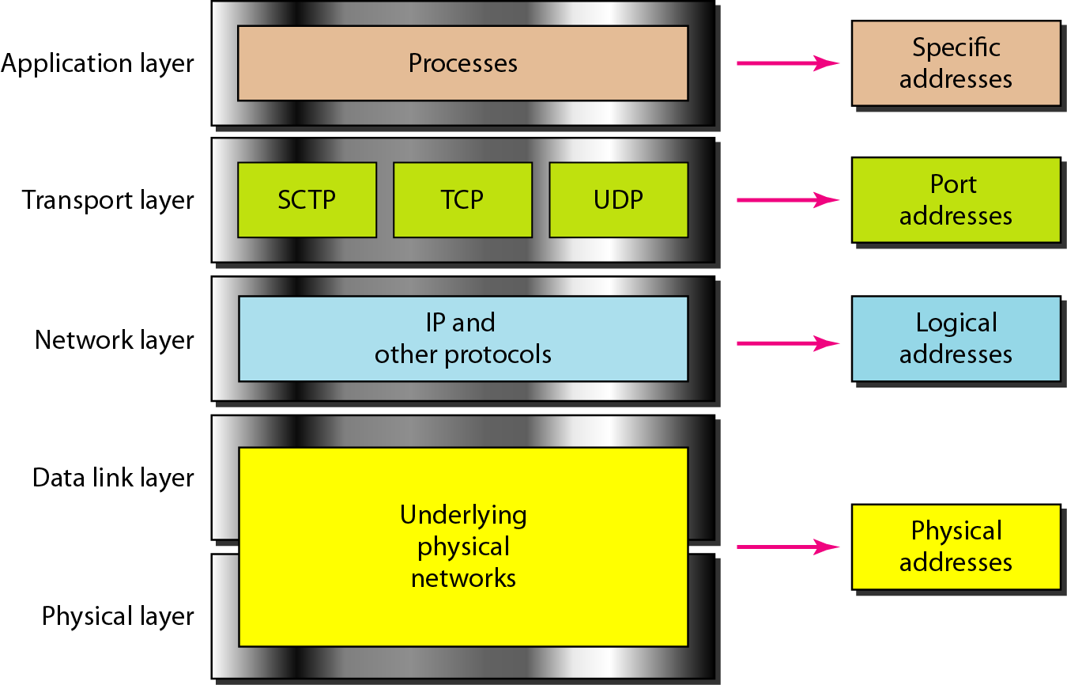
Relationship of layers and addresses in TCP/IP
IP Address
MAC Address
‹#›

Slide 71
Specific Addresses
Applications having user friendly addresses.
Email addresses or URLs.
john@gmail.comjohn@gmail.com or www.bracu.ac.bd
These are converted into corresponding port and logical addresses by the sending computer.
‹#›

Slide 72
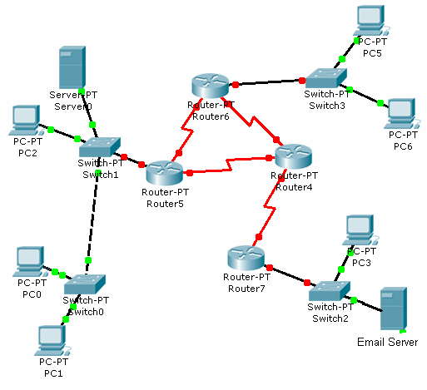

Addressing Review
13
11
M
A
k
a
Assume:
IP Addresses – Capital Alphabets
MAC Addresses – Numbers
Port Numbers- Small Alphabets
D S D S D S
F/22
D/13
G/31
E/21
B/12
H/32
IP address
N/41
Email
k
MAC address
A/11
Email
a
Web
c
M/42
Receiver
‹#›
Sender

Slide 73
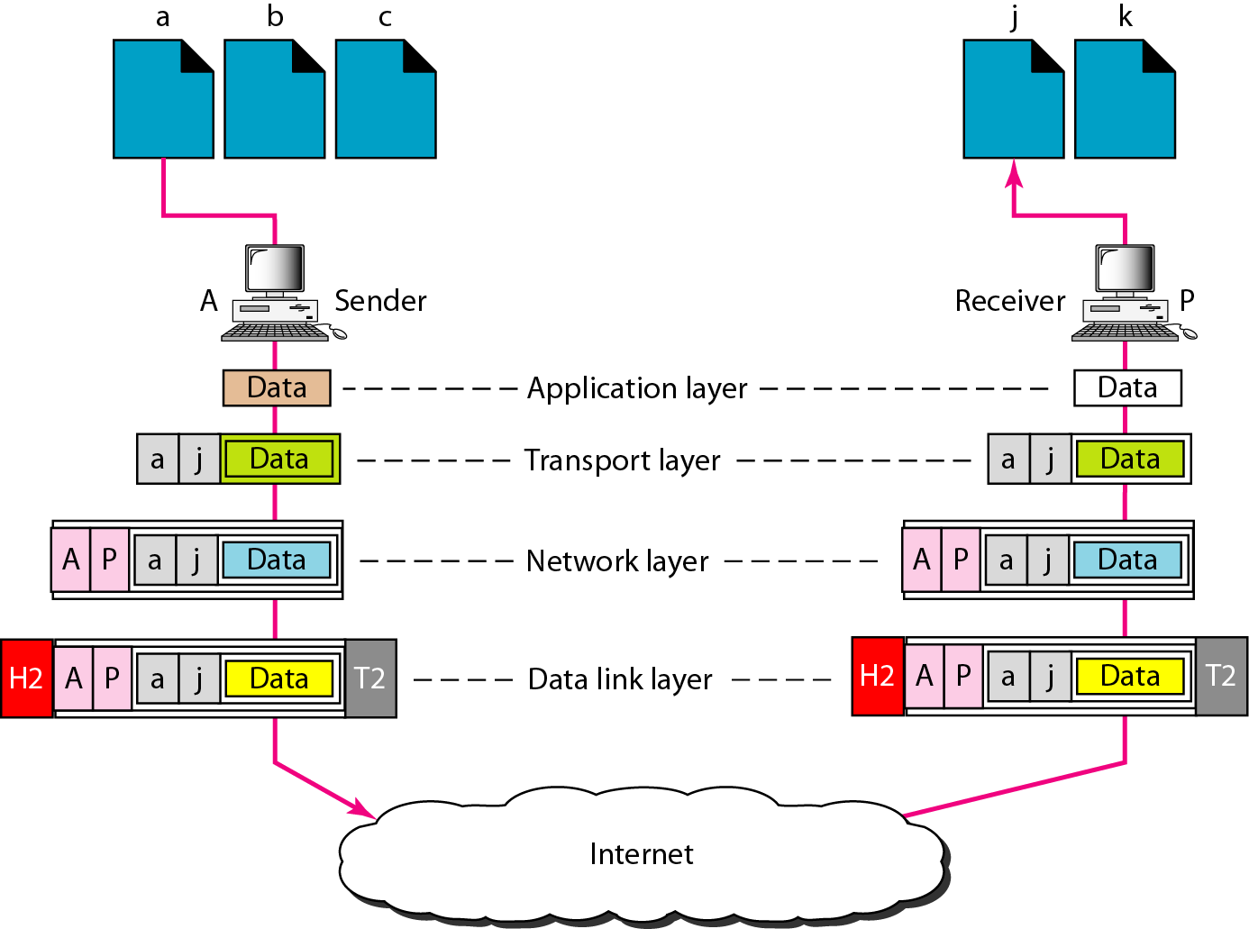
Addressing Review
Although physical addresses change from hop to hop, logical and port addresses remain the same from the source to destination.
‹#›

Slide 74
END
2.#
‹#›

